Slide 1

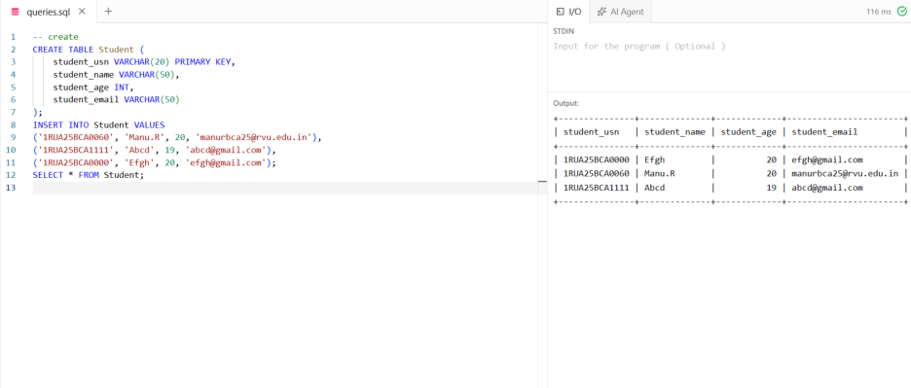
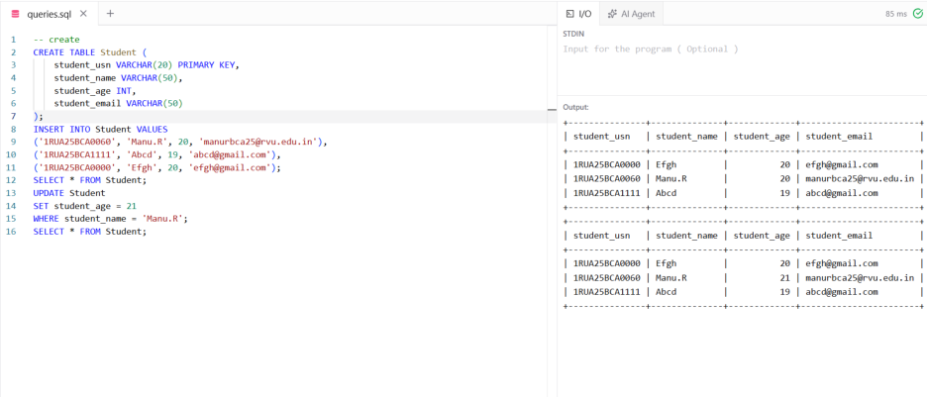
DML Commands
Inserting the values
Updating the Value
Deleting the value

Slide 2


